Slide 1
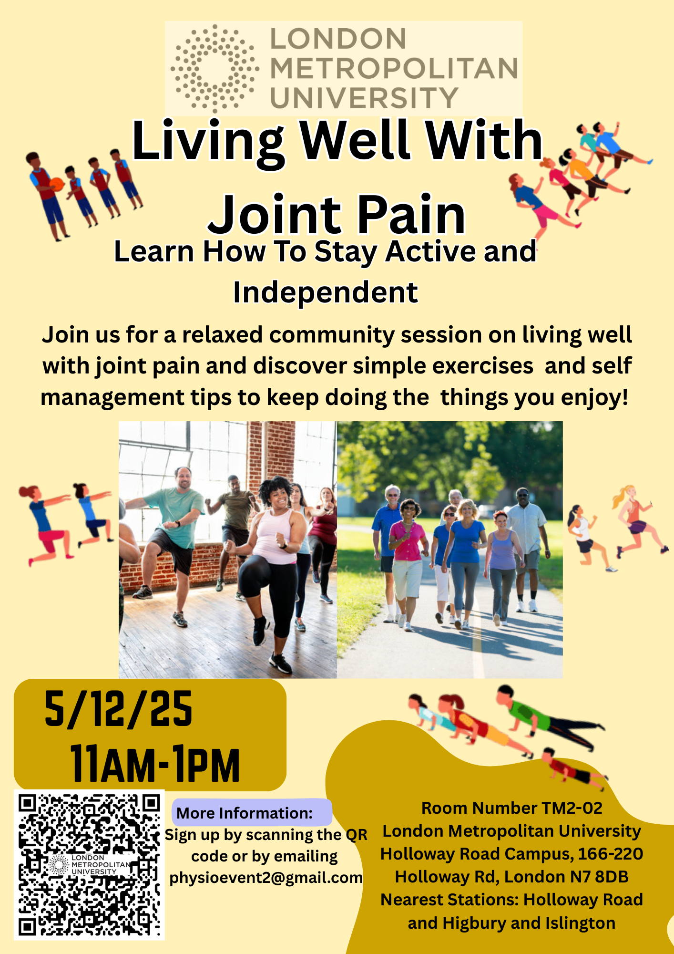
Joint Pain Event
Event Objectives
Understand common causes of joint pain
Learn simple and safe exercises to stay active
Learn self-management strategies
Available support and resources
Feedback form
Breaks
11am-1pm
Elvio and Honey
Physiotherapy Students
London Metropolitan University

Slide 2
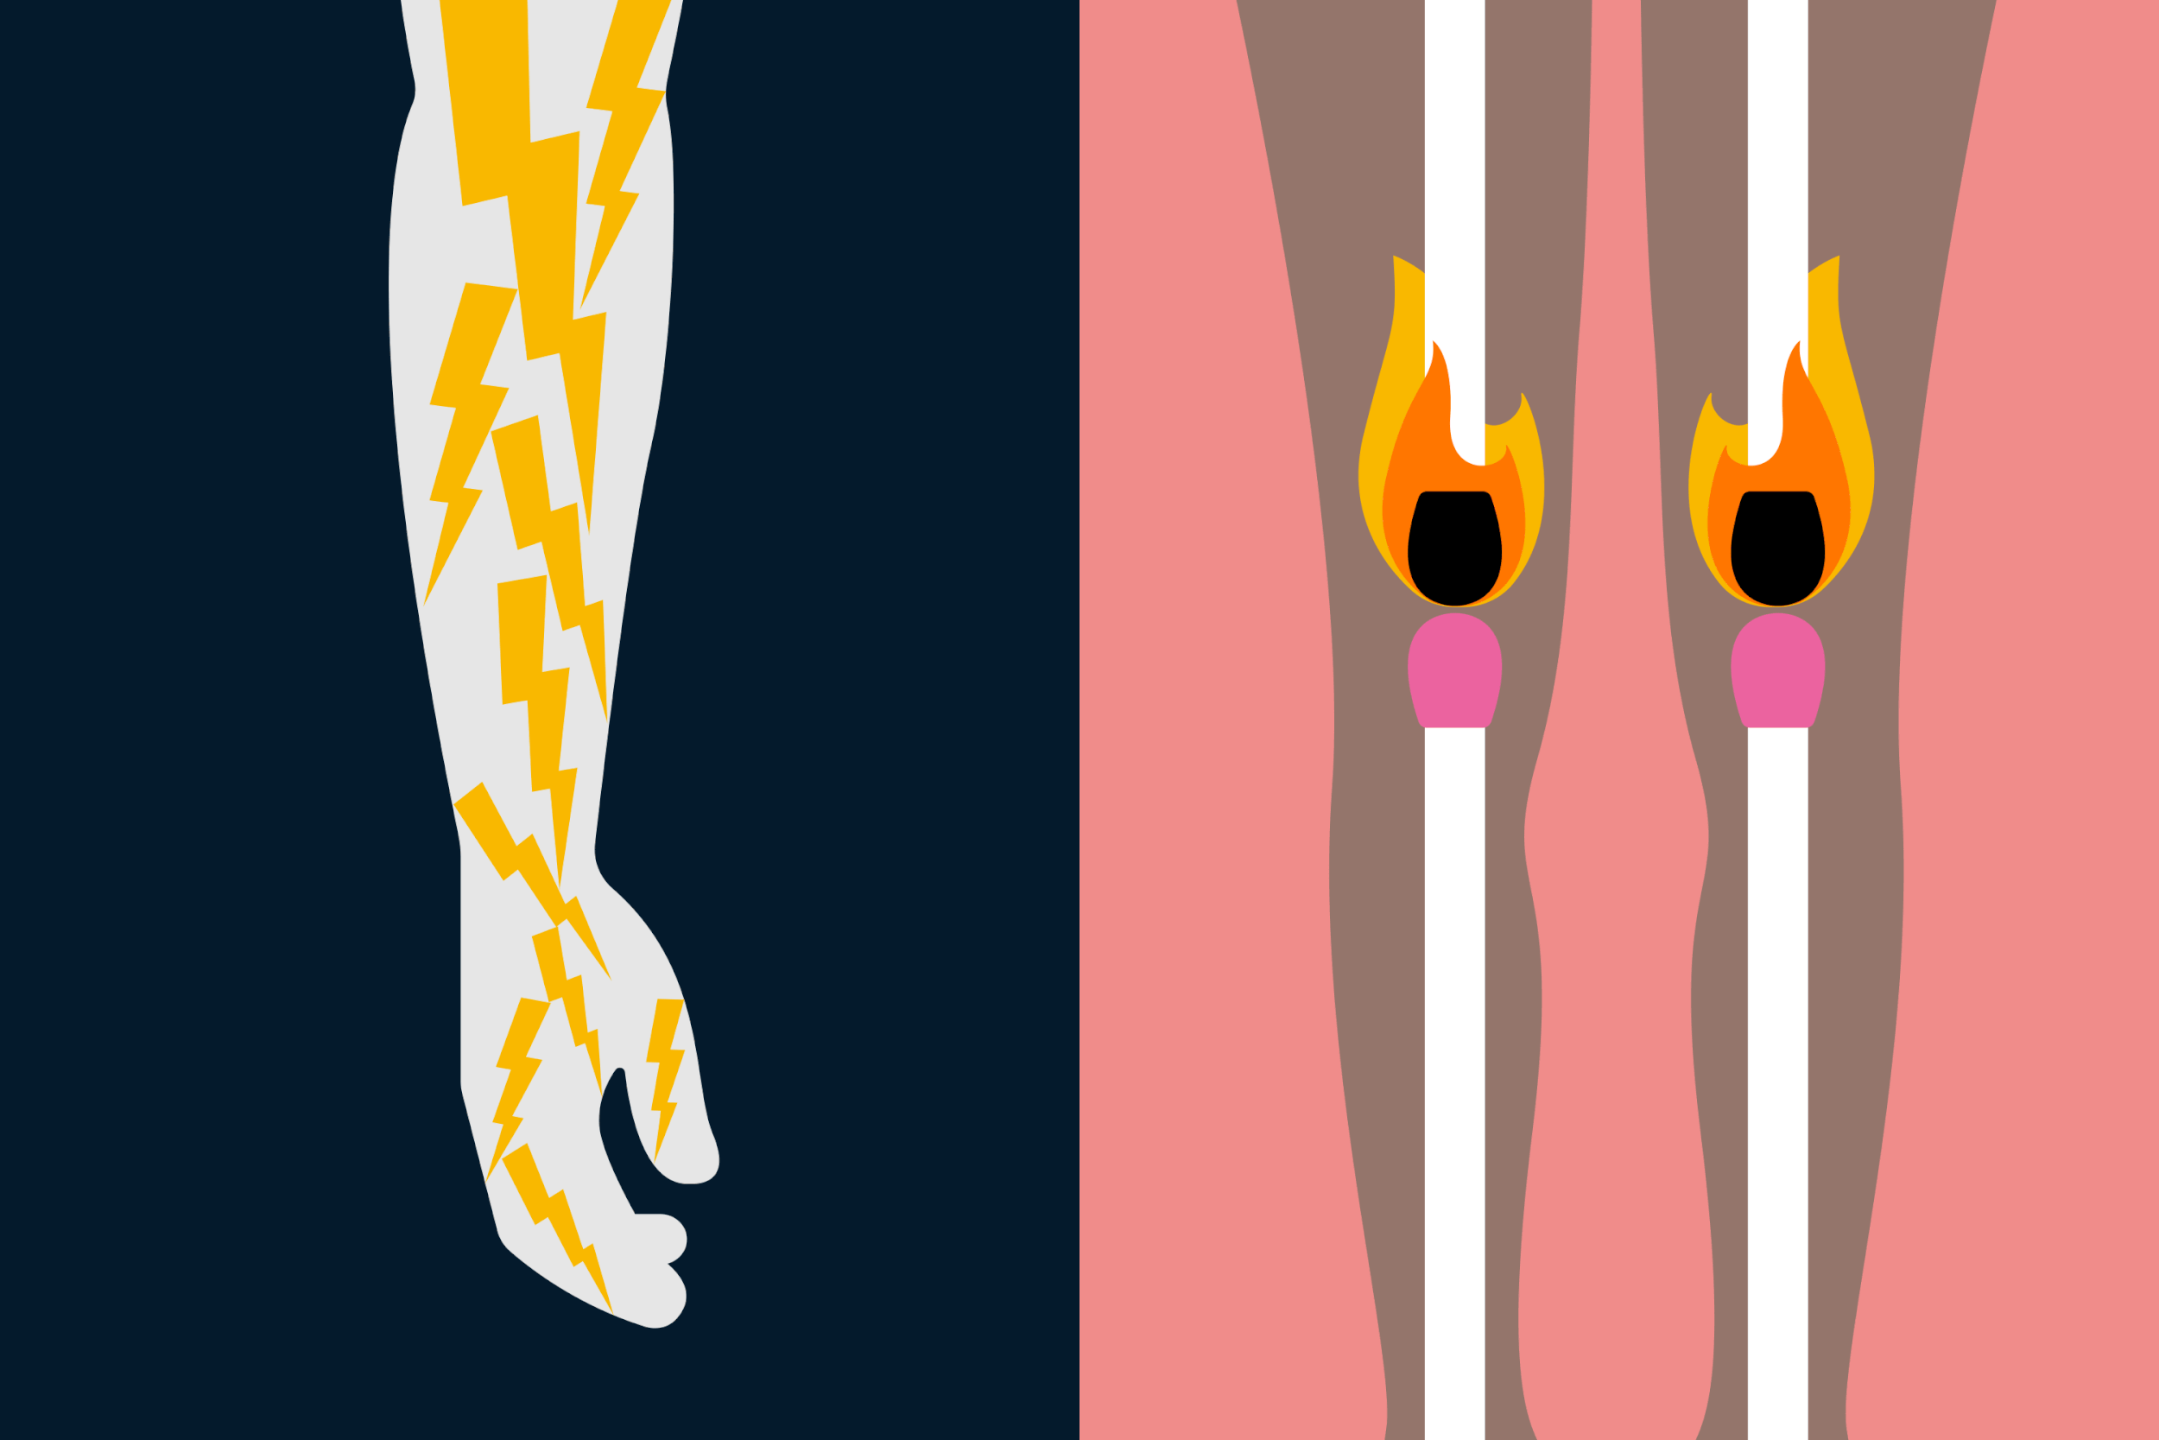
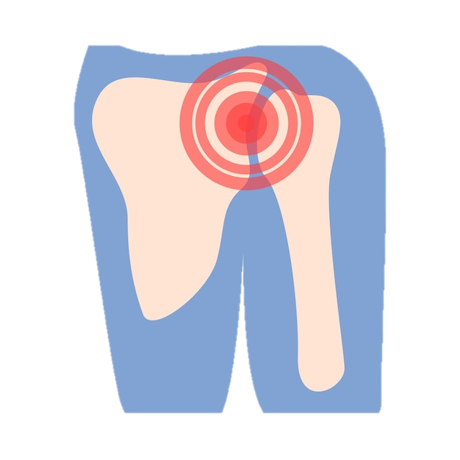
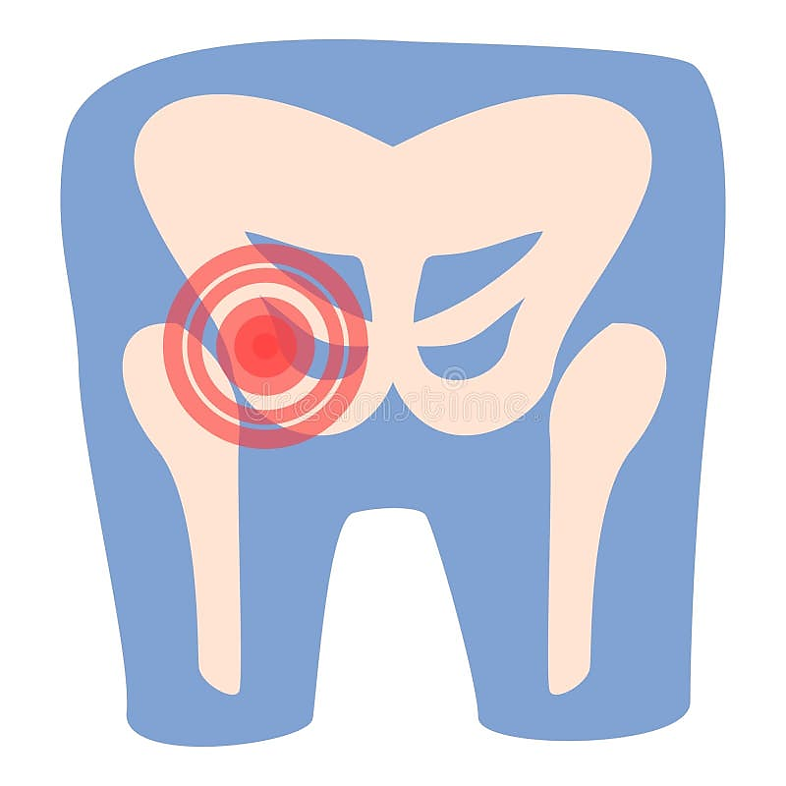
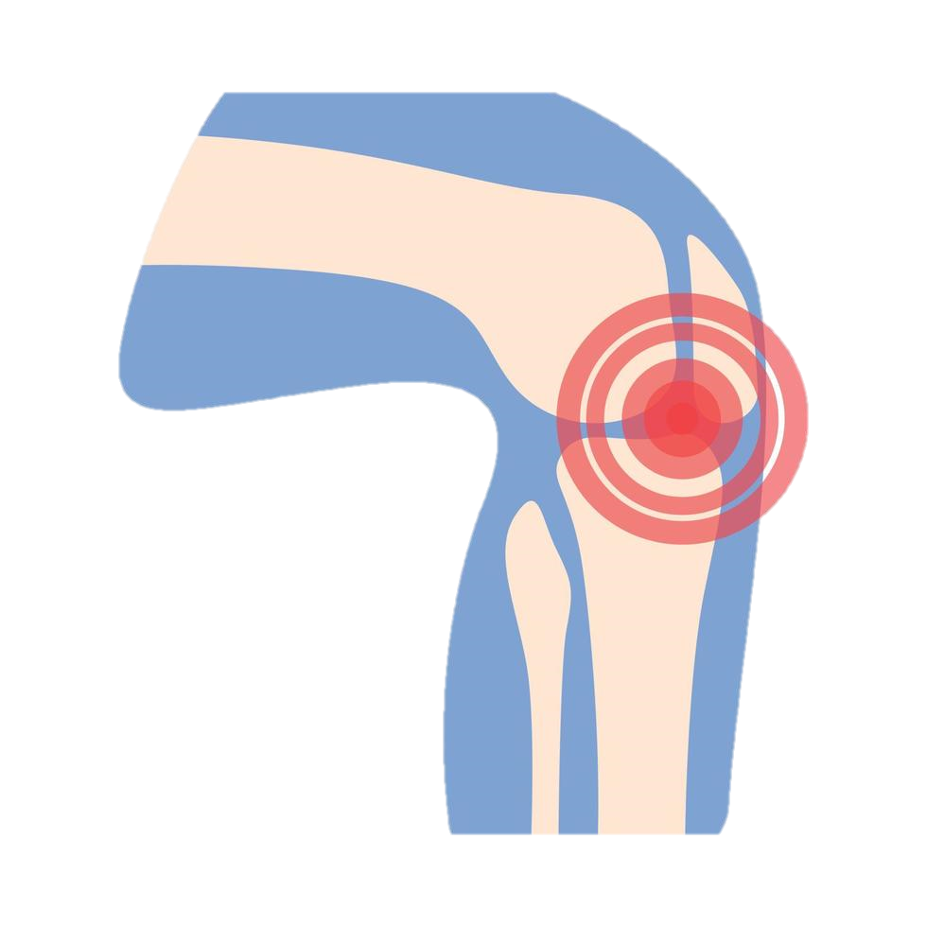
What is Joint pain?
Notes:
Honey slides

Slide 3
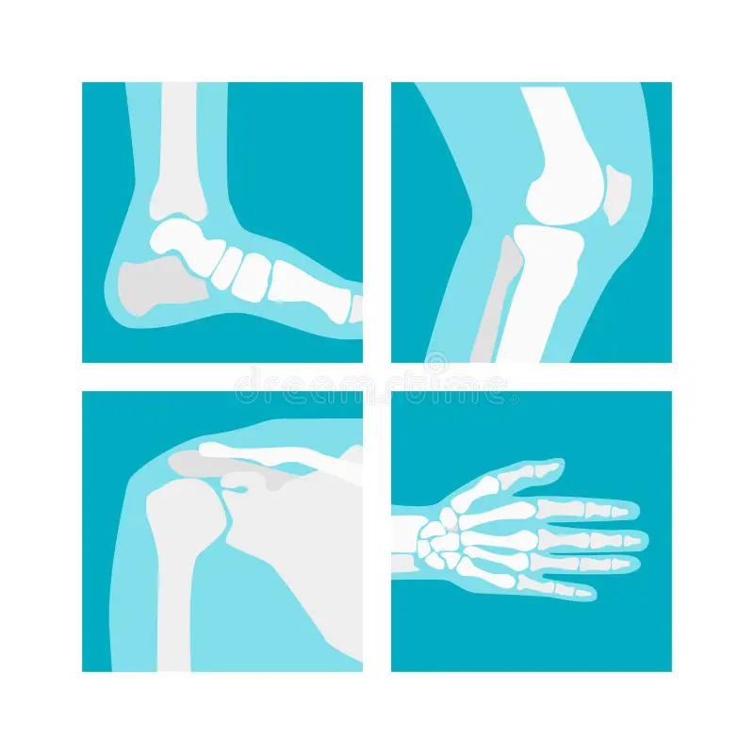


Arthritis | Tendonitis | Fybromyalgia
Wear and tear – (osteoarthritis) | Repetitive overuse of a tendon (common in sports or work-related tasks) | Sleep disturbances worsen pain sensitivity
Autoimmune disorders (e.g., Rheumatoid arthritis, Psoriatic arthritis) | Aging (tendons lose elasticity and become more prone to irritation) | Abnormal pain processing in the central nervous system
Genetics and family history | Previous tendon injury | Chronic stress leading to nervous system overactivity
Previous joint injuries | Tight muscles or lack of flexibility | Co-existing conditions (e.g., rheumatoid arthritis, lupus) which increase risk
Obesity (increases strain on weight bearing joints) | Diabetes | Hormonal imbalances affecting pain regulation
Smoking (linked with rheumatoid arthritis) | Muscle weakness or imbalance causing extra strain on tendons | Physical or emotional trauma (e.g., accidents, long-term stress)
Notes:
Honey slides

Slide 4
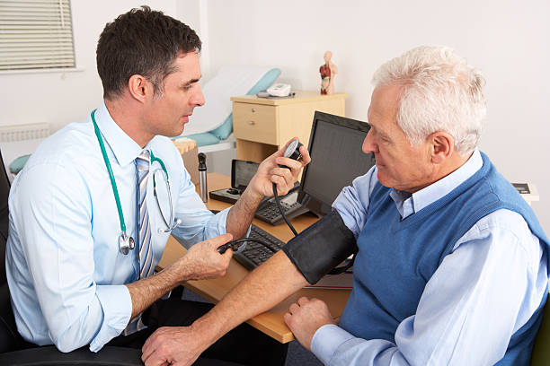
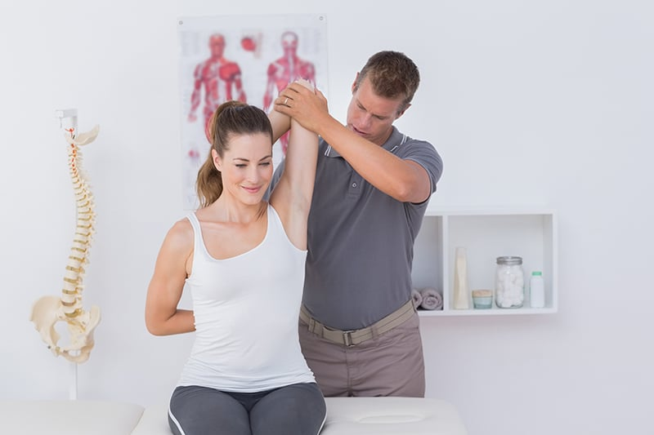
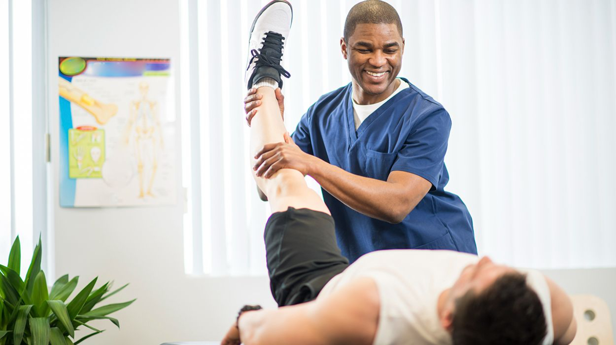
Roles in Healthcare
Physiotherapists
Assess movement and joint function
Provide tailored exercises
Teach flare-up management
General Practitioners (GP)
Diagnose conditions
Prescribe medications and injections
Refer to other healthcare professionals/services
Osteopaths
Use hands-on techniques to improve mobility
Advise on posture, movement and exercise
Support long-term self-management
Notes:
Can ask questions:
What they do in healthcare
And how they help with joint pain?

Slide 5

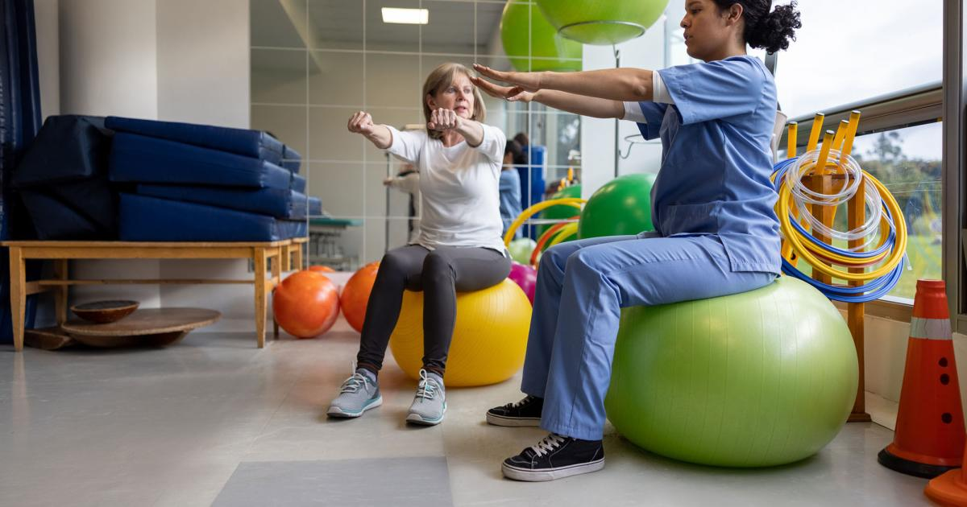

Roles in Healthcare
Pharmacists
Advise on medication use
Check medication interactions and side effects
Quick access to medications
Social Prescribers
Connect patients with community services
Support lifestyle changes and emotional well-being
Help people stay active socially and physically.
Occupation Therapists (OTs)
Help people manage daily activities
Recommend equipment and home adaptations
Teach joint-protection and pacing strategies
Notes:
Can ask questions:
What they do in healthcare
And how they help with joint pain?

Slide 6


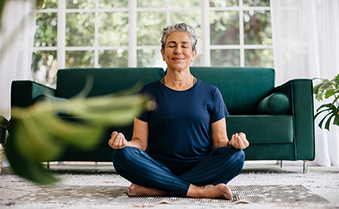

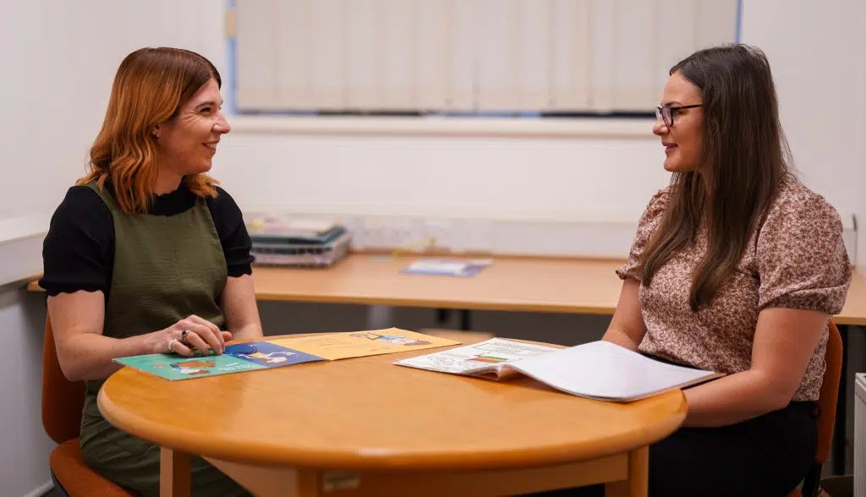
What is Self-Management?
Actions a person takes to manage their health, particularly when living with a long-term/chronic condition
Adjusting your lifestyle
Creating a support network
Maintaining psychological well-being
Handling flare-ups
Developing skills, confidence and knowledge

Slide 7
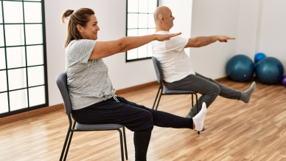

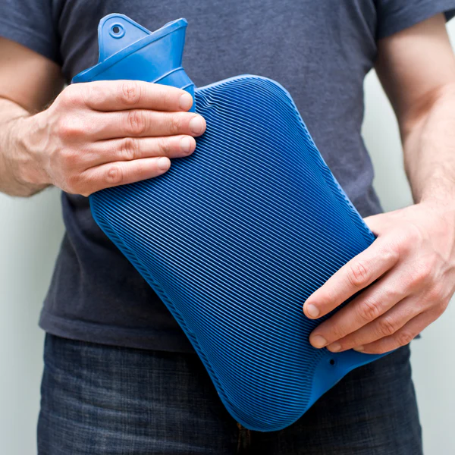
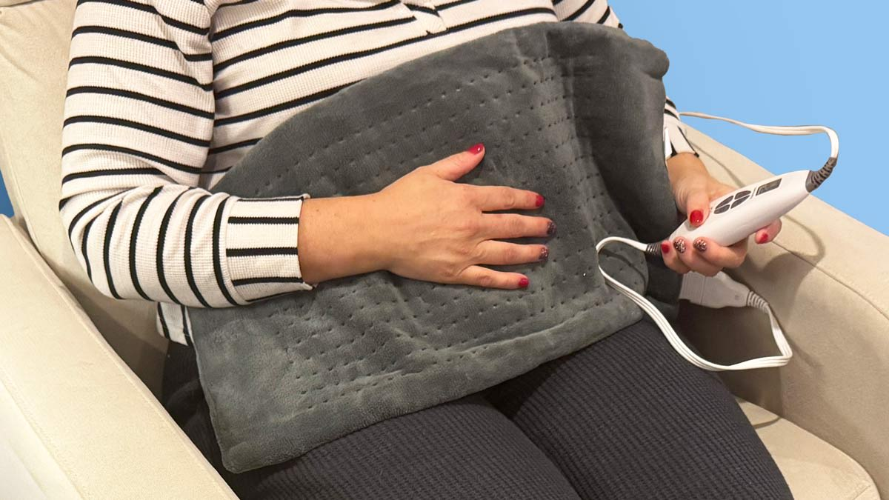
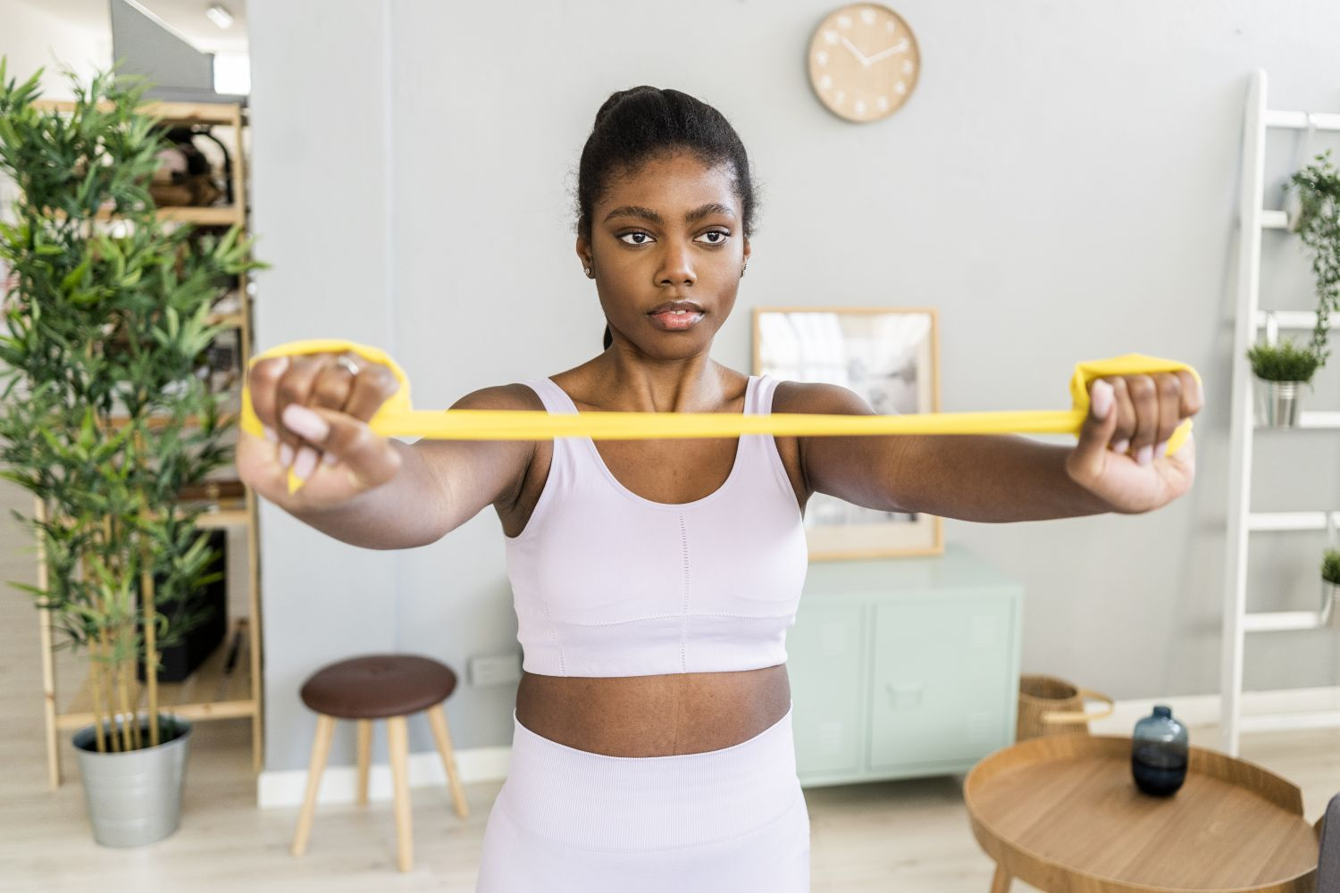


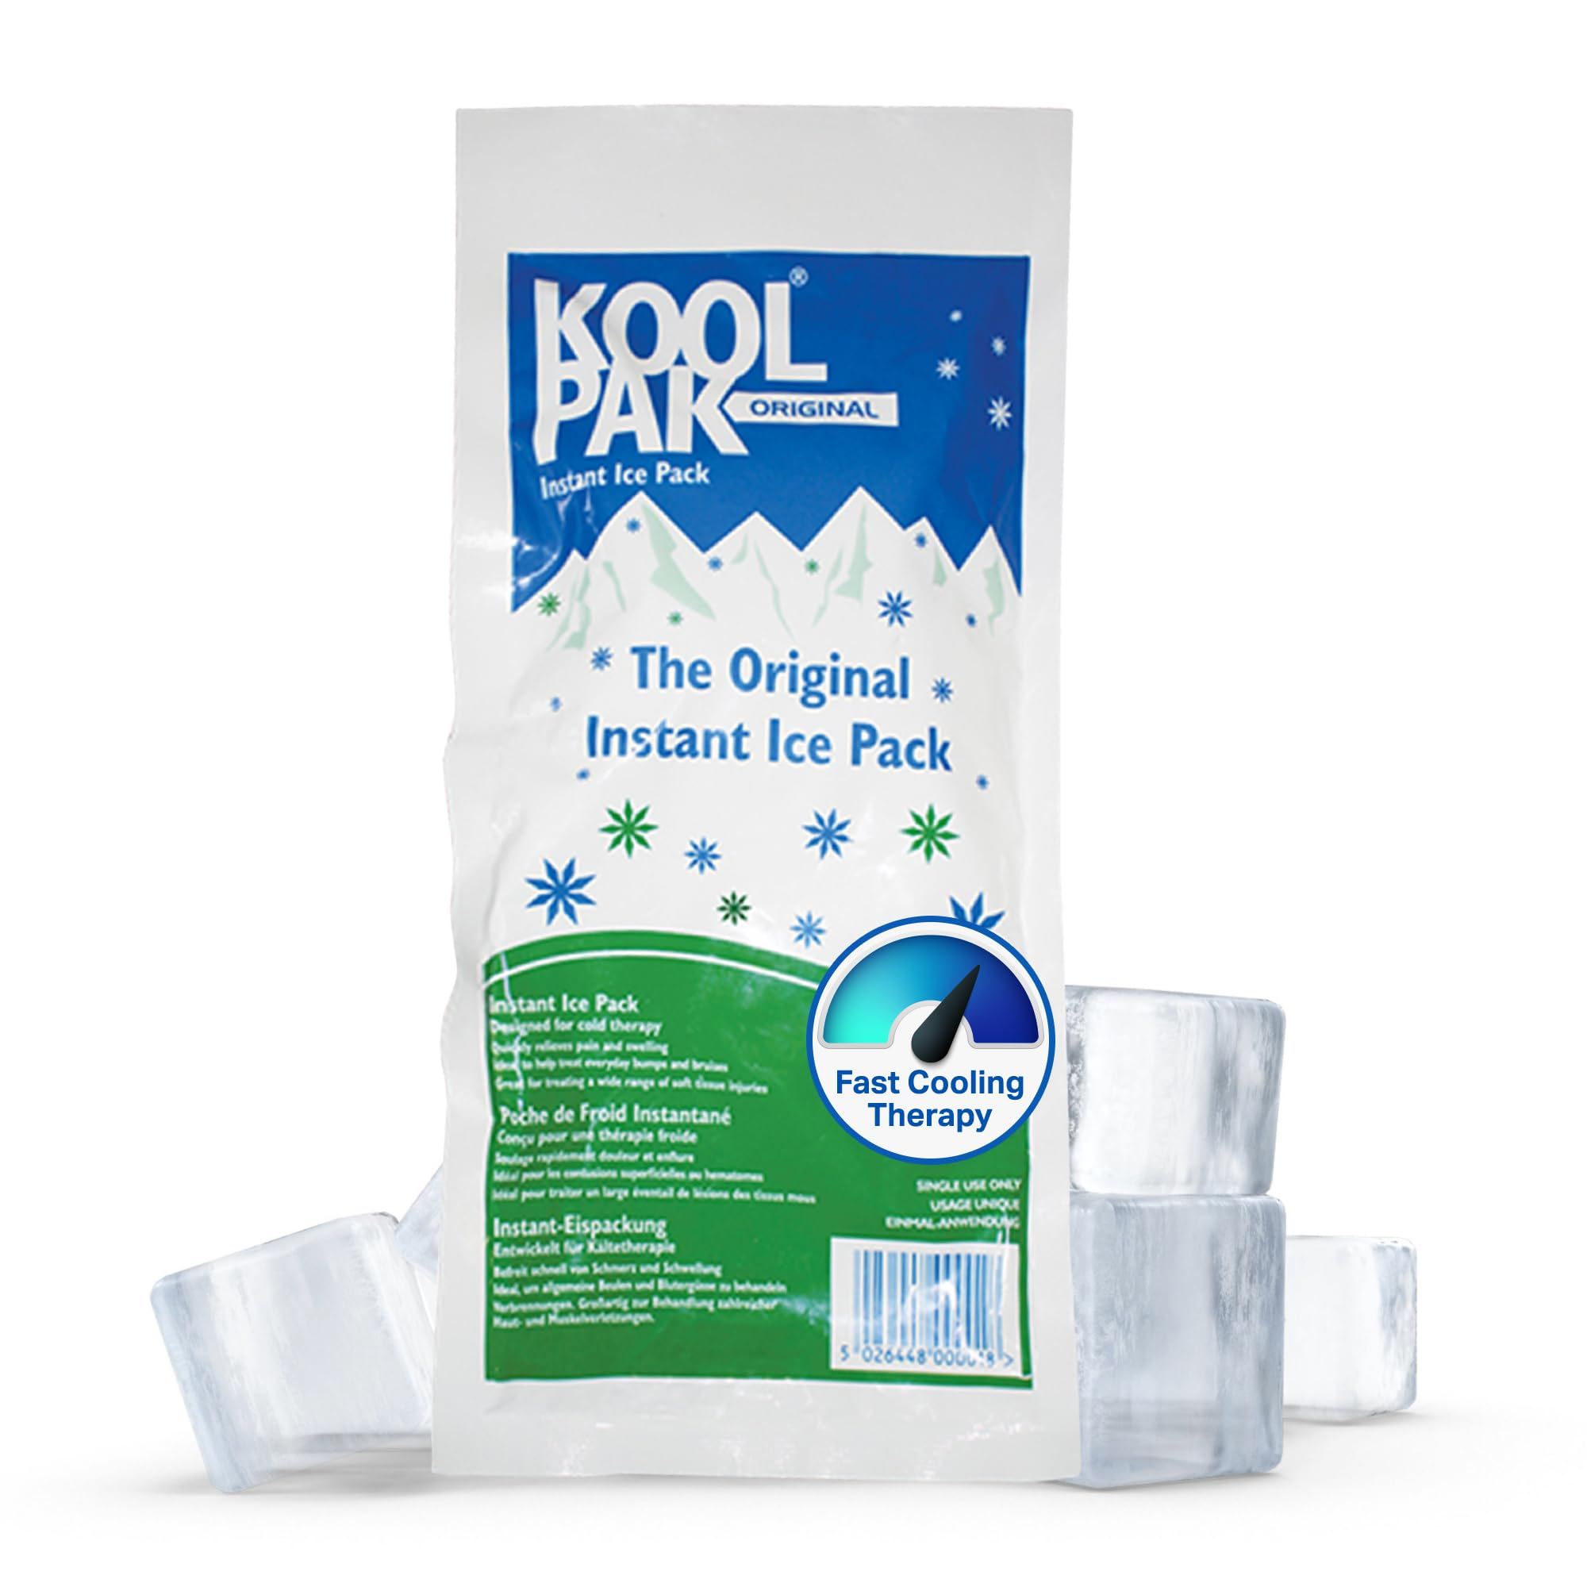
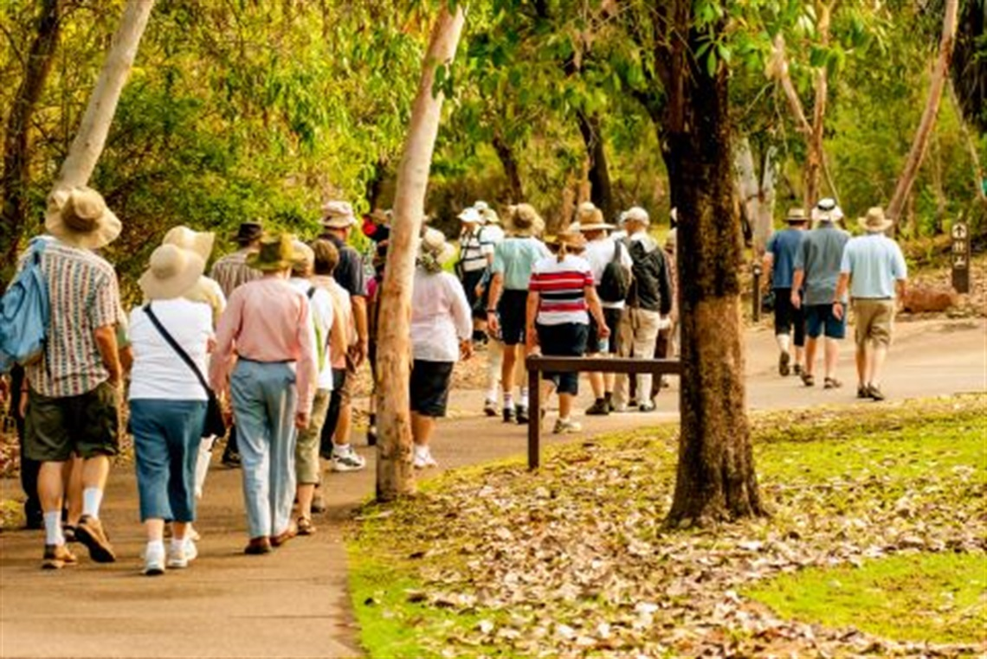
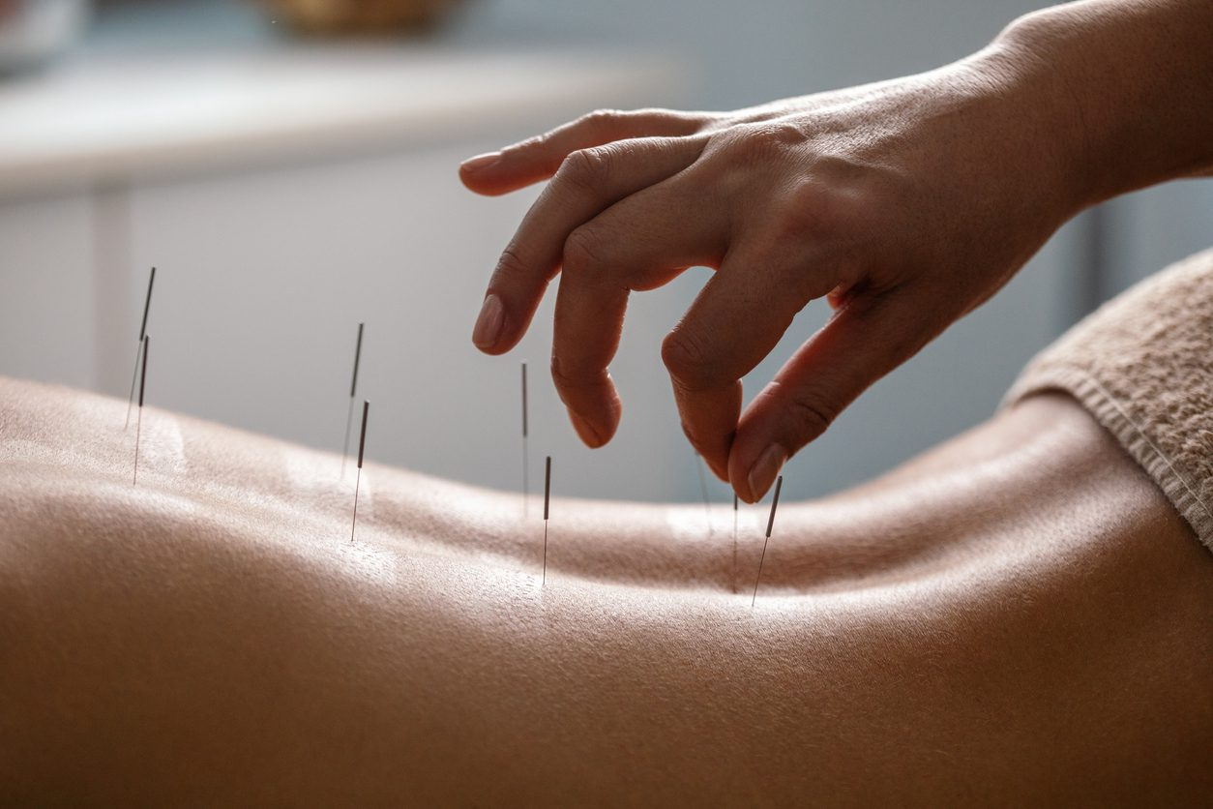
Ways to Self-Manage
Gentle exercises
Medications
Heat packs
Banded exercises
Taking breaks
Sauna
Cold Packs
Walking groups
Acupuncture

Slide 8
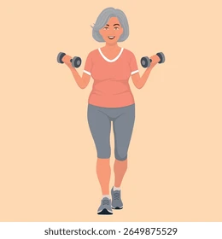


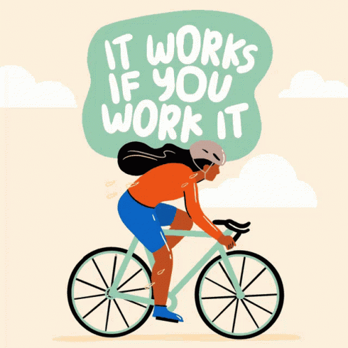
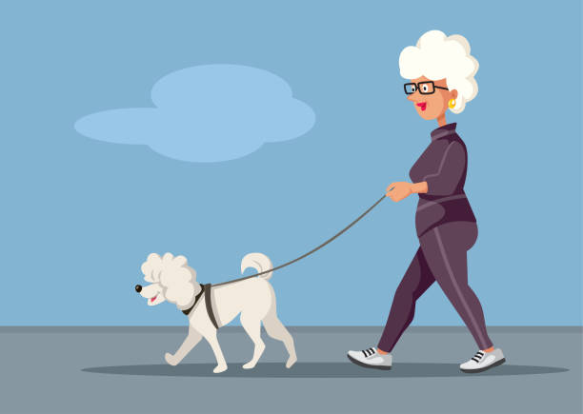
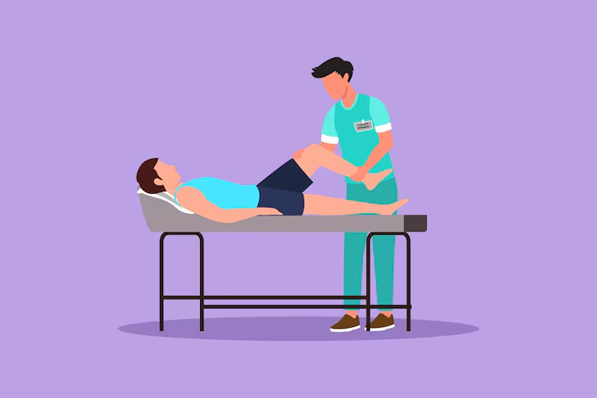
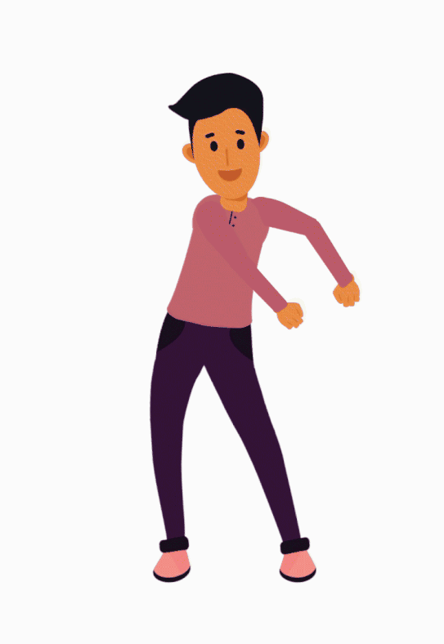
Self Management!
Invest in your hobbies!
Mindfulness
Socialising
You can do these great activities as a group!
Click any image to find your local COMMUNITY CENTRES and online groups!
Swimming
Badminton
Cycling
Yoga
Dancing
Walking
Sauna
Massage
Get up and move! ☺
Osteopathy

Slide 9
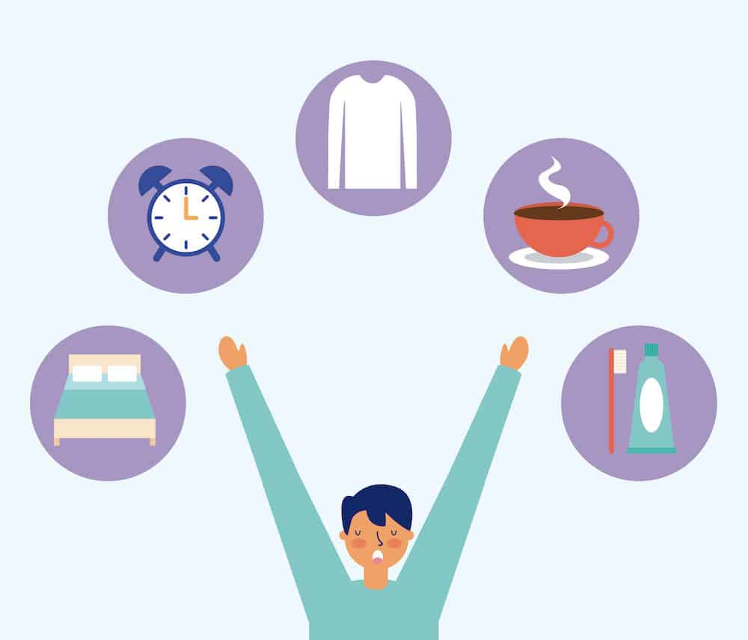

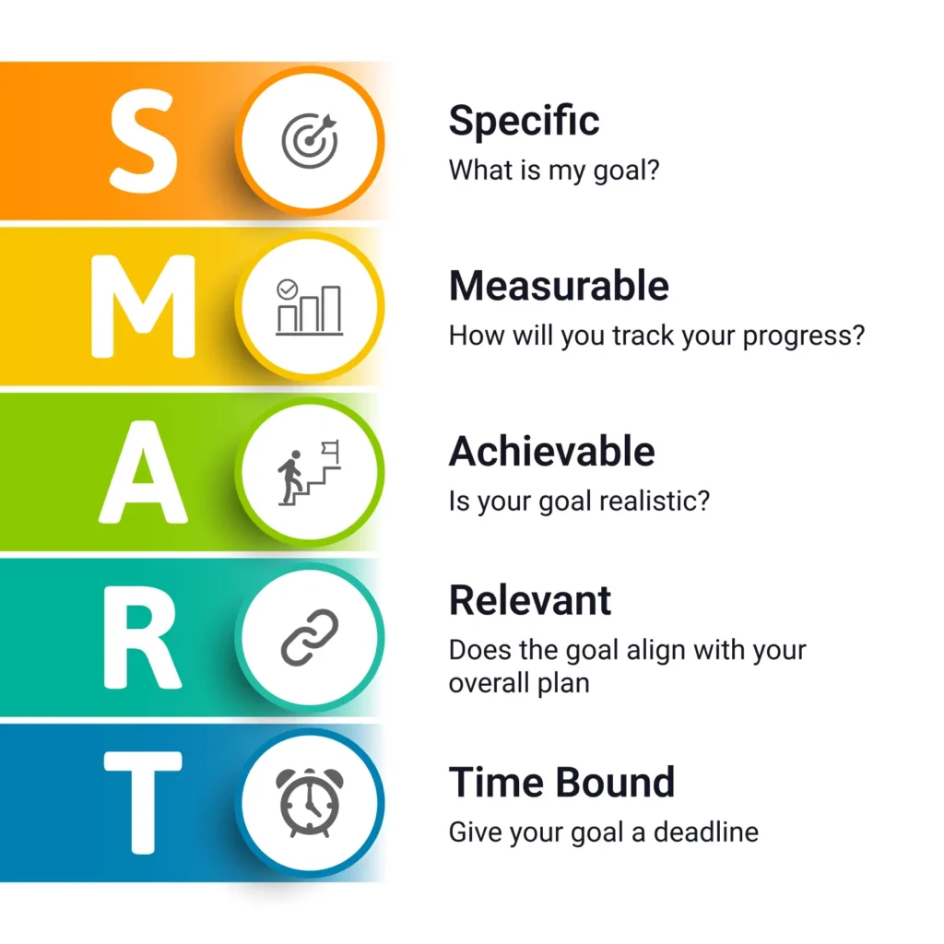
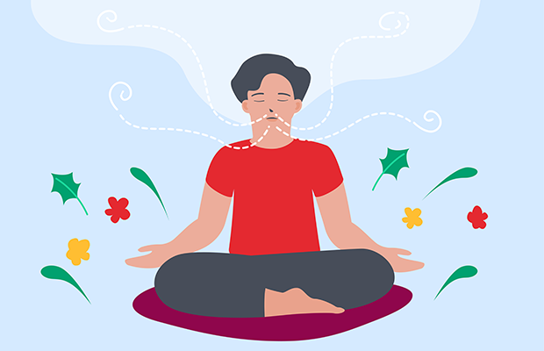
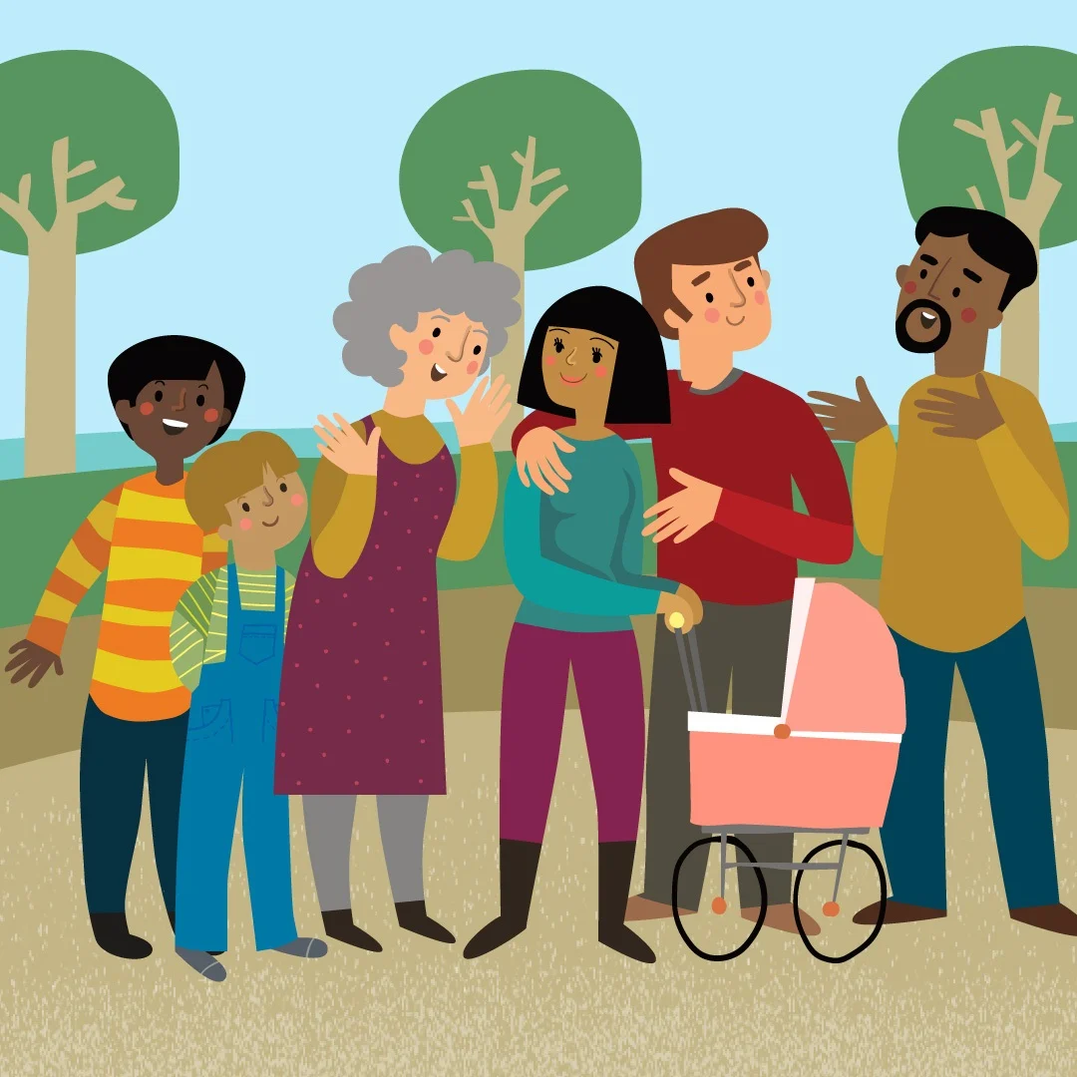
Ways to improve psychological well-being
Maintaining a routine
Attending Workshops
Deep breathing exercises
Having a support network
Setting SMART goals

Slide 10
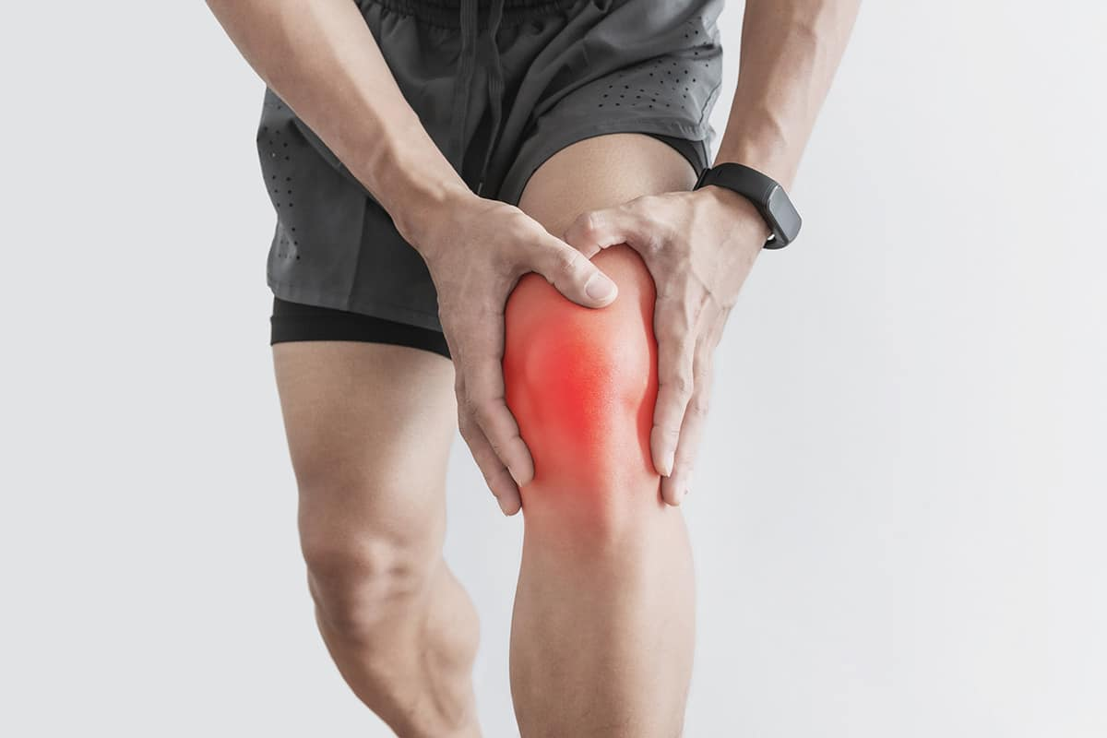
What is SMART
S
M
A
R
T
Specific
Measurable
Achievable
Realistic
Time Bound
Knee Pain – Strength Goal
S – Specific:
Do sit-to-stand exercises from the dining chair.
M – Measurable:
10 reps, twice per day.
A – Achievable:
Uses a chair already at home; low equipment needed.
R – Relevant:
Improves knee strength and supports daily tasks like standing up.
T – Time-bound:
Every day for 14 days.
SMART Goal:
“Starting Monday, I will complete 10 sit-to-stand reps from the
dining chair twice a day for 14 consecutive days.”

Slide 11
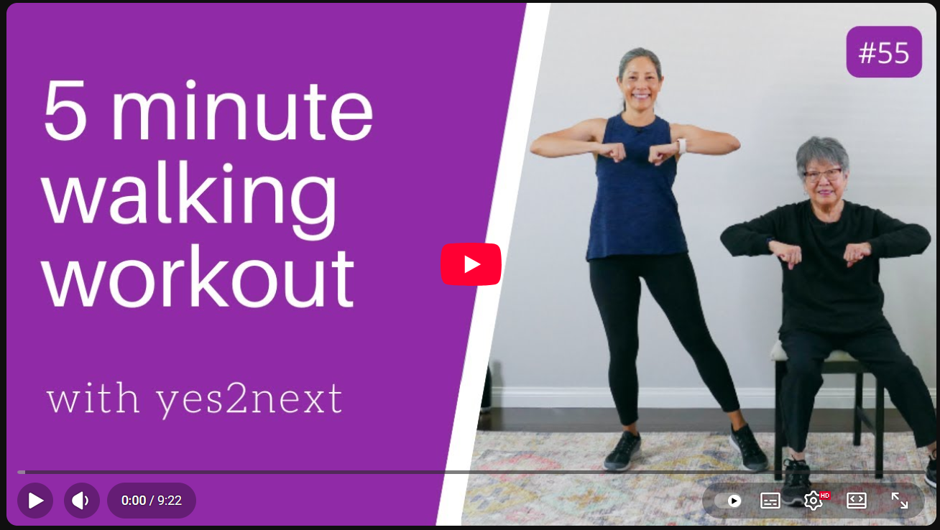
Exercises to do at home
5 minute Indoor Walking Workout | Seniors, Beginners

Slide 12








Resources Available
 | A free 12-week YouTube 30min follow along movement program from Venus Arthritis https://www.arthritis-uk.org/information-and-support/living-with-arthritis/health-and-wellbeing/exercising-with-arthritis/lets-move-with-Leon/
 | Online coffee mornings/ tea afternoons and Arthritis Action groups where people share tips on how to self-manage their arthritis https://www.arthritisaction.org.uk/
 | Free 12-week weight loss programme https://www.more-life.co.uk/places-we-work/camden-and-islington/
 | Webinars about arthritis, how to manage the pain, movement with arthritis and many more. Over 70 1-hour long https://www.arthritis.org/events/webinars/past-webinars
 | Job support for unemployed with joint pain and health support for free https://shawtrust.org.uk/msk-trailblazer/
 | A text service to talk to someone about pain https://giveusashout.org/get-help/issues/support-chronic-pain/
 | A Pain helpline contact number https://painconcern.org.uk/helpline
 | Free Joint pain program provided by Nuffield Health https://www.nuffieldhealth.com/about-us/our-impact/healthy-life/joint-pain-programme/joint-pain-programme
 | Free information booklet about arthritis, joint pain, movement and many more https://shop.arthritis-uk.org/collections/free-information-booklets

Slide 13


Slide 14

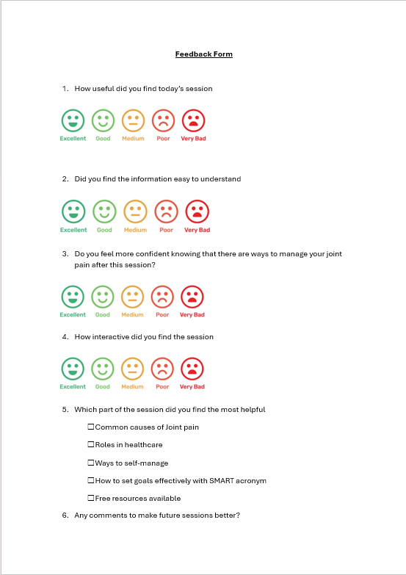
Thank You and Feedback

